Slide 1
Youth, Entrepreneurship, Human Capital and Education
The 2024 Official LDC U.S. Latino GDP Report
Produced by
In partnership with

Slide 2
Access the Report

Slide 3
The LDC’s U.S. Latino GDP Report
This year’s report:
Forecasts Latino economy through 2029.
Presents data on U.S. Latino entrepreneurs: firm creation, employment generation, receipts, etc.
In-depth analysis of Latino youth.

Slide 4
Key Metrics of Latino Progress
Gross Domestic Product (GDP): Expenditures made “by and on behalf of” Latinos
Gross Domestic Income (GDI):
Income earned from the productive activities of Latinos
Latino Purchasing Power (LPP):
Combined ability of Latinos to purchase goods and services

Slide 5
Executive Summary
$3.6 trillion U.S. Latino GDP
Real annual growth of 4.6% (2017-2022)
28.3% real GDP growth generated by Latinos (2017-2022)
Domestic income valued at $2.8 trillion
$3.8 trillion Latino purchasing power (LPP)

Slide 6
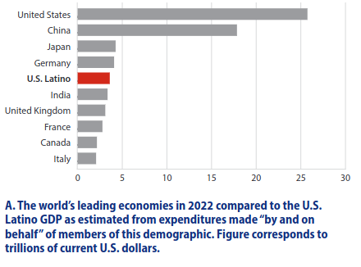
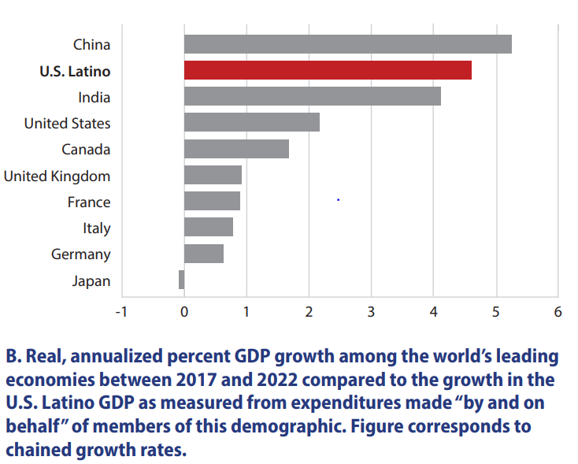
International Perspective

Slide 7
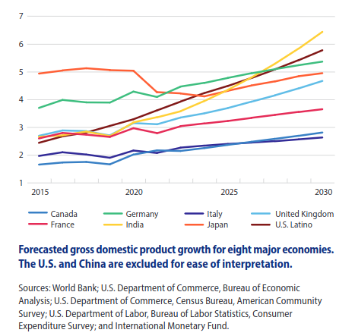
Future Growth of the U.S. Latino Economy

Slide 8
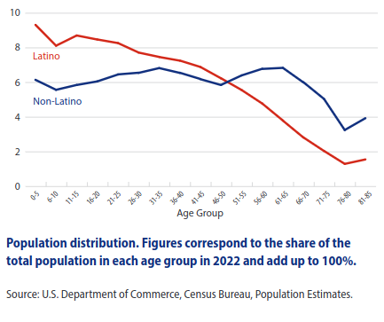
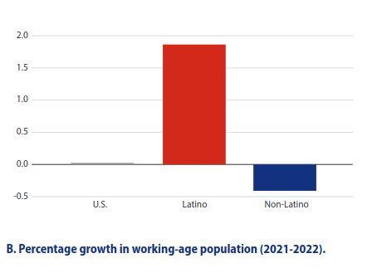
Drivers of Growth: Population

Slide 9
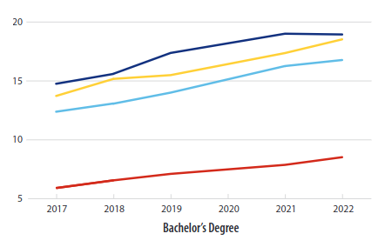
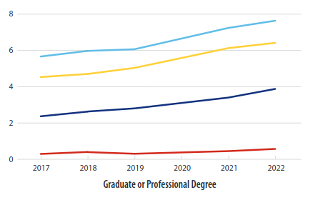
Drivers of Growth: Education

Slide 10
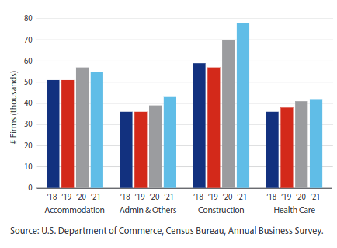
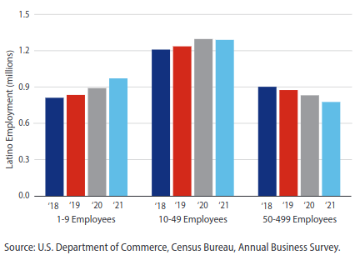
Drivers of Growth: Entrepreneurship

Slide 11
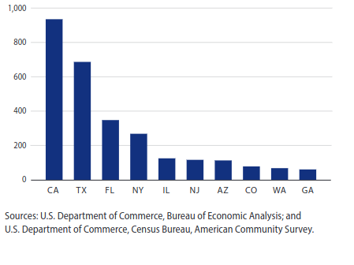
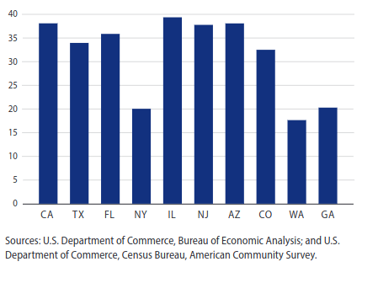
State Latino GDP & Share Growth Contributed

Slide 12
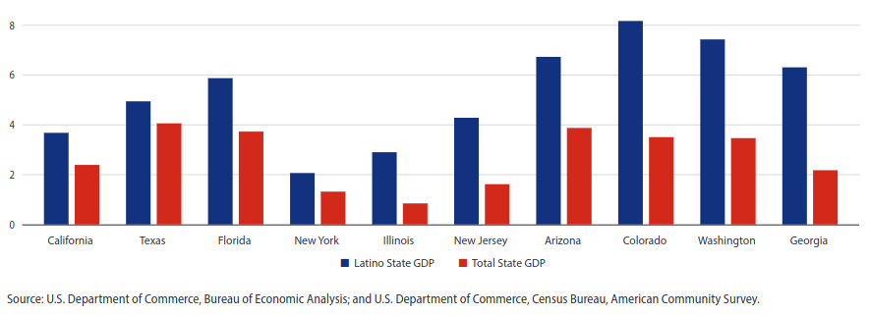
State Latino Economic Growth (2017-2022)

Slide 13
Key Takeaways
U.S. Latinos power our nation’s economy demonstrated by:
Population growth
Entrepreneurship
Educational attainment
Drivers of growth unlikely to change in the medium run
Latinos are a key foundation of state economies

Slide 14
Contact Us
Ana Valdez
President & CEO, Latino Donor Collaborative
info@latinocollaborative.org
https://www.latinodonorcollaborative.org
Latino Donor Collaborative
@LDCLatino

