Slide 1
Election Impact 2025: The Cost of Deportations
Joseph Garcia
Vice President of Public Policy

Slide 2
Established 1969 in Phoenix as part of the Chicano movement
Operations in Arizona, Nevada, New Mexico, Texas, California and Colorado (and Utah soon)
We have about 2,000 employees
One of nation’s largest Latino organizations
Despite our name, we help anyone in need

Slide 3
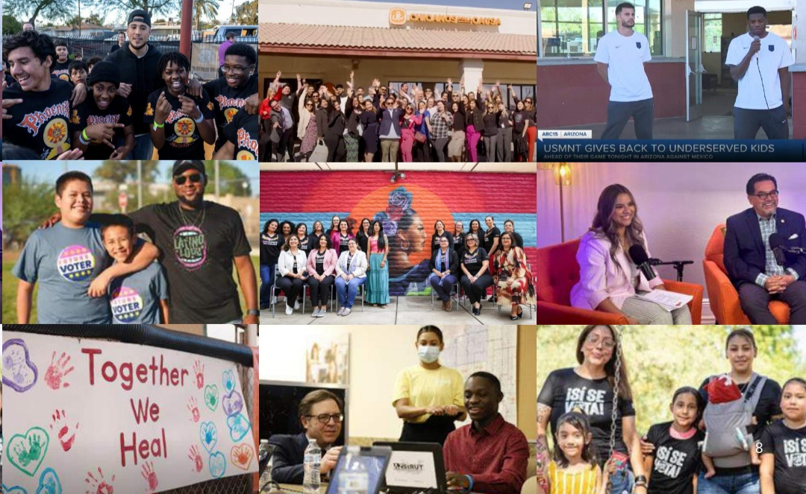
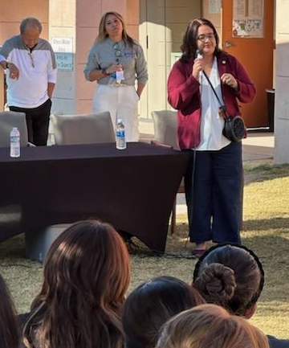
Health & Human Services
Housing
Education
Economic Development
Advocacy

Slide 4
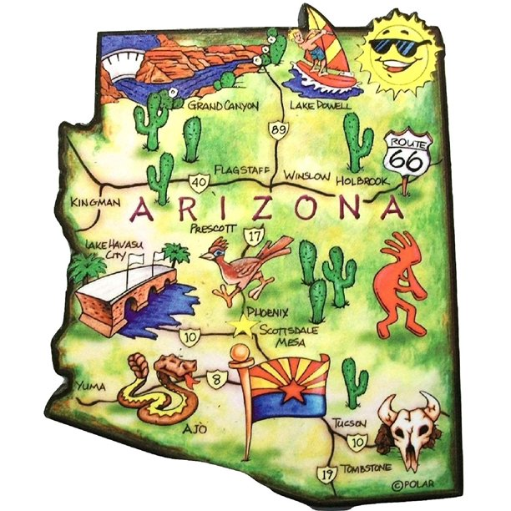
Arizona Population by Decade
2020 7.15 million
2010 6.39 million
2000 5.13 million
1990 3.67 million
1980 2.73 million
1970 1.77 million
1960 1.32 million
756,000 Sources: Census, MicroTrends

Slide 5
Arizona Population by Decade
2030 8.1 millon
2020 7.15 million
2010 6.39 million
2000 5.13 million
1990 3.67 million
1980 2.73 million
1970 1.77 million
1960 1.32 million
756,000

Slide 6
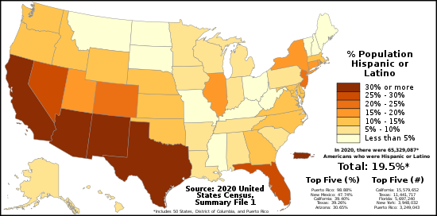
The Browning of America

Slide 7
Arizona
Increasingly Latino
2.3 million
Latinos
One-third
of AZ population
Source: American Community Survey from the U.S. Census Bureau

Slide 8
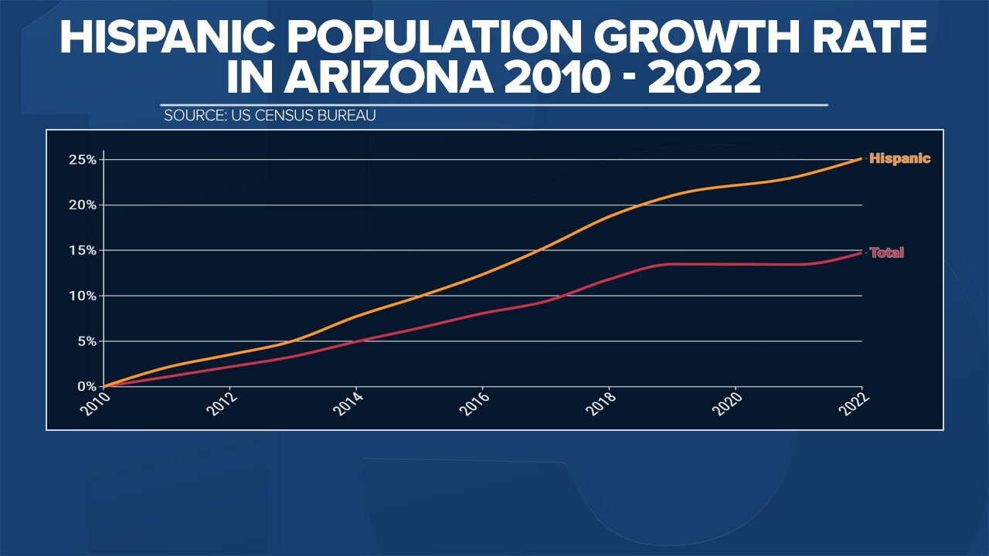
Source: American Community Survey from the U.S. Census Bureau

Slide 9
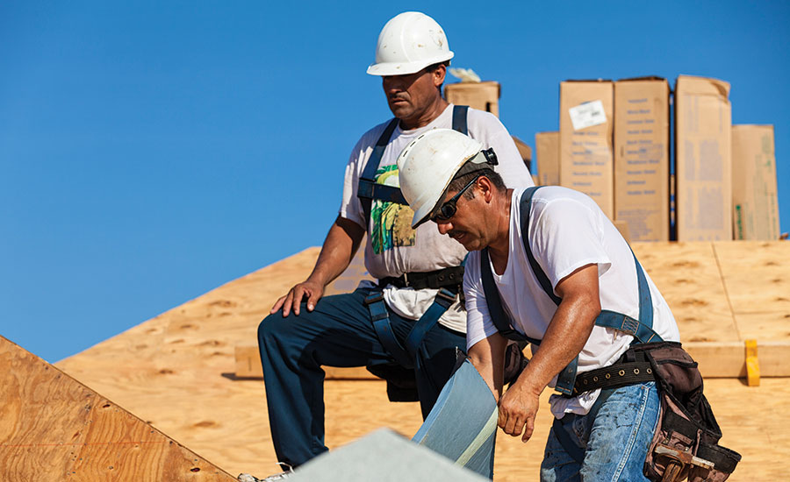
Arizona Latino Employment
Latinos increasingly make up our state and nation’s workforce. In fact, Latino men in Arizona have the highest rate of labor force participation at 76%.
White men are at 62% labor force participation.
Source: UCLA Latino Policy and Politics Institute

Slide 10
Arizona Latino Snapshot
Latinos in Arizona are young. With a median age of 27, the Latino population is significantly younger than Arizonans overall (37 for non-Latinos).
Around 20% of Latinos in Arizona are children ages 0 to 10 (compared with less than 15% of Arizona’s population)
Less than 10% of Latinos are aged 61 and older (versus over 20% of Arizona overall).
Source: UCLA Latino Policy and Politics Institute

Slide 11
Arizona Latino Education
30% of AZ Latinos did not complete high school, much higher than the state overall (13%).
21% of AZ Latinas and 19% of AZ Latinos have associate’s degree or higher (compared with 45% of non-Latino Whites).
Source: UCLA Latino Policy and Politics Institute

Slide 12
Arizona Latino Household Income
47% of AZ Latinos live in poverty or low-income conditions. By comparison, 32% of AZ population lives in poverty or low-income households.
Latinos have the third-lowest median household income in Arizona ($48,900) — almost $10,000 below state median household income ($58,500) and slightly lower than the median household income of Latinos nationally ($51,800).
Source: UCLA Latino Policy and Politics Institute

Slide 14
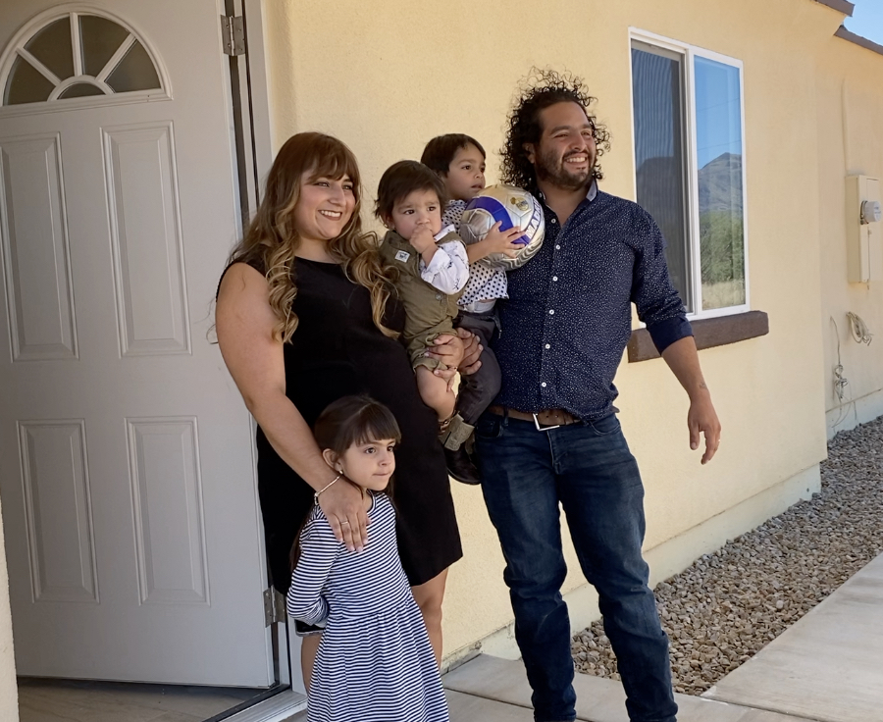
Latino economic impact
Arizona Latino gross domestic income (GDI) totaled $72.6 billion in 2021.
That represents about 17% of the state's GDI and 26% of Arizona's GDI growth between 2011 and 2021.
Arizona's Latino GDP is 7th largest, behind California, Texas, Florida, New York, Illinois and New Jersey.
Total economic output of U.S. Latinos reached $3.2 trillion in 2021 — more than total GDP of every nation except U.S., China, Japan and Germany.
Sources: 2023 U.S. Latino GDP Report, U.S. Census

Slide 15
Election 2024
Source: American Community Survey from the U.S. Census Bureau

Slide 16
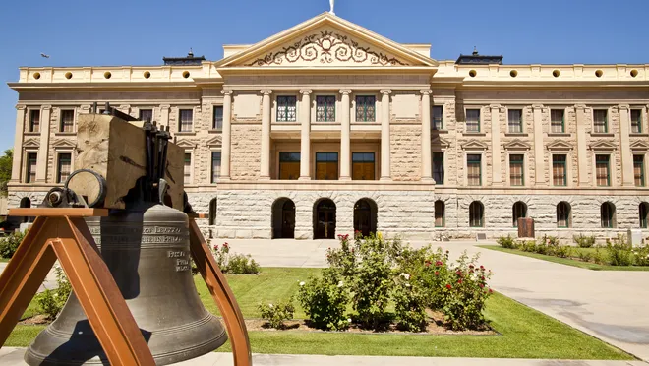
Politics by Party
U.S. Congress
Senate
52 GOP
45 Dem
Ind
Vacancy
House
220 GOP
215 Dem
Arizona Legislature
Senate
16 GOP
14 Dem
House
31 GOP
29 Dem

Slide 17
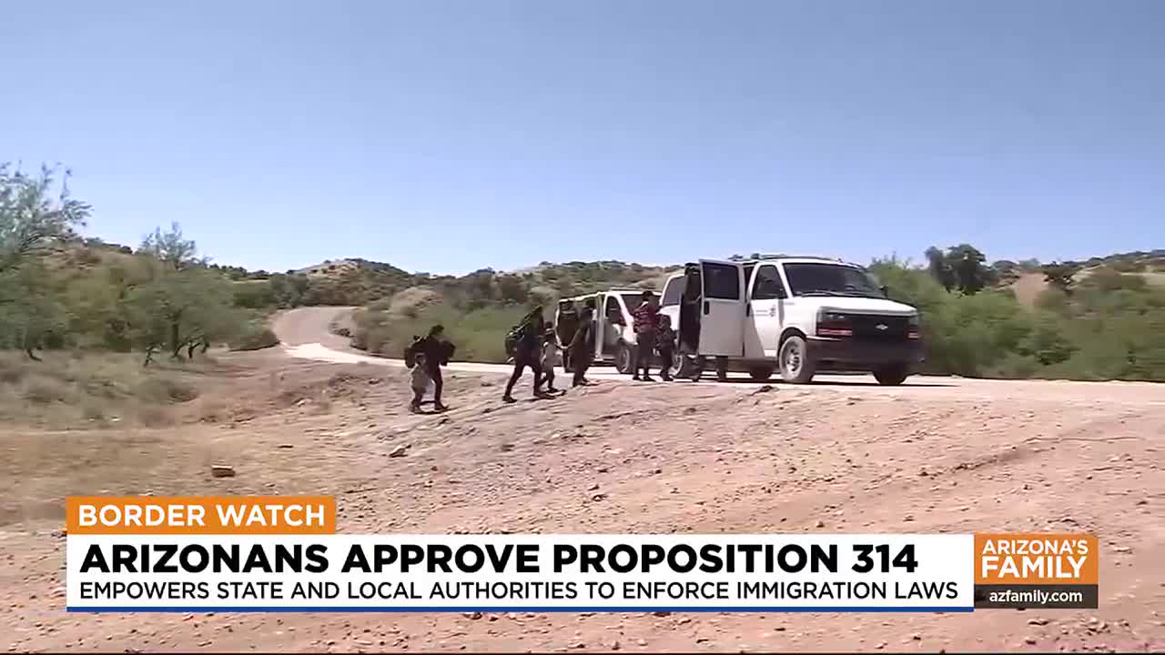
Proposition 314
aking it a state crime for noncitizens to enter the state at any location other than the port of entry;
allowing for state and local police to arrest noncitizens who cross the border unlawfully;
allowing for state judges to order deportations;
requiring the use of E-Verify program in order to determine the immigration status of individuals before the enrollment in a financial aid or public welfare program;
making it a Class 6 felony for individuals who submit false information or documents to an employer to evade detection of employment eligibility, or to apply for public benefits, and;
making the sale of fentanyl a Class 2 felony if the person knowingly sells fentanyl and it results in the death of another person.

Slide 18
Prop 314:
Secure the Border Act
Makes it a state crime for noncitizens to enter the state at any location other than the port of entry.
Allows state and local police to arrest non-citizens who cross the border unlawfully.
Grants “civil immunity” for "state or local government entity, official, employee or contractor” for such actions
Allows state judges to order deportation.
Requires use of E-Verify program in order to determine immigration status of individuals before enrollment in a financial aid or public welfare program.
Makes it a Class 6 felony for individuals who submit false information or documents to an employer to evade detection of employment eligibility, or to apply for public benefits.
Makes sale of fentanyl a Class 2 felony if person knowingly sells fentanyl and it results in the death of another person.
.

Slide 19
Prop 314:
Secure the Border Act
GOP Border Priorities for Arizona
Support implementation of Proposition 314, which has overwhelming public support.
Ensure law enforcement has every resource necessary to enforce this law.
Strengthen Arizona’s sanctuary city ban by requiring active local compliance with both Proposition 314 and federal immigration officials.
Ensure statewide law enforcement support of federal efforts “to keep our communities safe and end the scourge of fentanyl and human trafficking.”
Increase oversight of refugee agencies that contract with the state to ensure compliance with state and federal law enforcement and immigration law.
Increase penalties for fentanyl trafficking and possession.

Slide 20
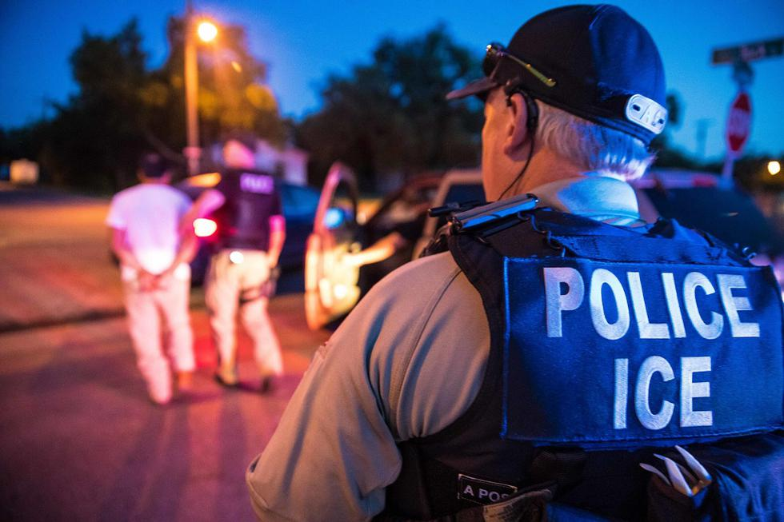
Trump Deportation Plan

Slide 21
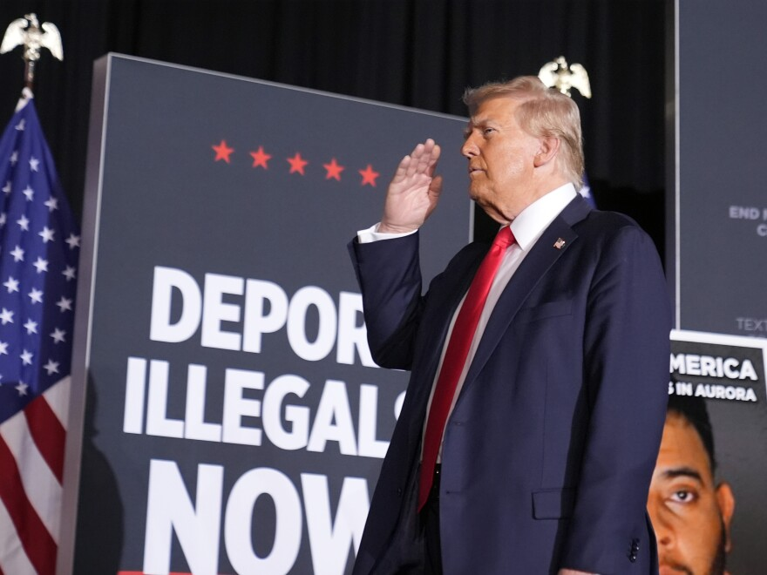
President-elect Donald Trump plans to use military for mass deportations despite legal limits.
National Guard would support deportations but not make arrests.
The American Immigration Council estimates 1 million deportations a year would require ICE to hire 30,000 new officers, "instantly making it the largest law enforcement agency in the federal government."
Deportation effort could cost nearly $1 trillion over a decade.
Trump: “There is no price tag” that will prevent deportations.
"I consider it an invasion of our country.” – Trump

Slide 22
Immigration Enforcement
Laken Riley Act would require federal authorities to detain undocumented immigrants charged with burglary, theft, larceny or shoplifting.
Proposed law would broaden the list of charges that would subject them to being held and potentially deported.
Under current law, noncitizens who have been convicted of at least two petty offenses are subject to potential deportation.
Expected reintroduced bills to increase deportations, hold asylum applicants outside of the United States and strip federal funding from cities that limit cooperation with federal immigration enforcement authorities.

Slide 23
Immigrants in United States
47.8 million immigrants in the United States in 2023.
11 million undocumented immigrants in U.S.
5.8 million of U.S. homes have at least one undocumented resident.
4.7 million households have undocumented residents and U.S. citizens or others with legal status.
More than half of the U.S. undocumented population has been in U.S. for at least 10 years.
5.5 million U.S.-born children live in households with at least one undocumented resident, including 1.8 million living in households with two undocumented parents.
Pew Research Center, Center for Migration Studies

Slide 24
Immigrants in United States
Mass deportation would push nearly 10 million U.S. citizens into economic hardship.
Median household income for mixed-status households would decrease, from $75,500 to $39,000 (a drop of over 48%).
Taxpayer cost of upbringing U.S.-born children in the event of mass deportation is estimated to be at least $116.5 billion.
Undocumented workers contribute an estimated $96.7 billion in federal, state, and local taxes.
8.3 million undocumented immigrants work in the U.S. economy, or 5.2% of the workforce.
Pew Research Center, Center for Migration Studies

Slide 25
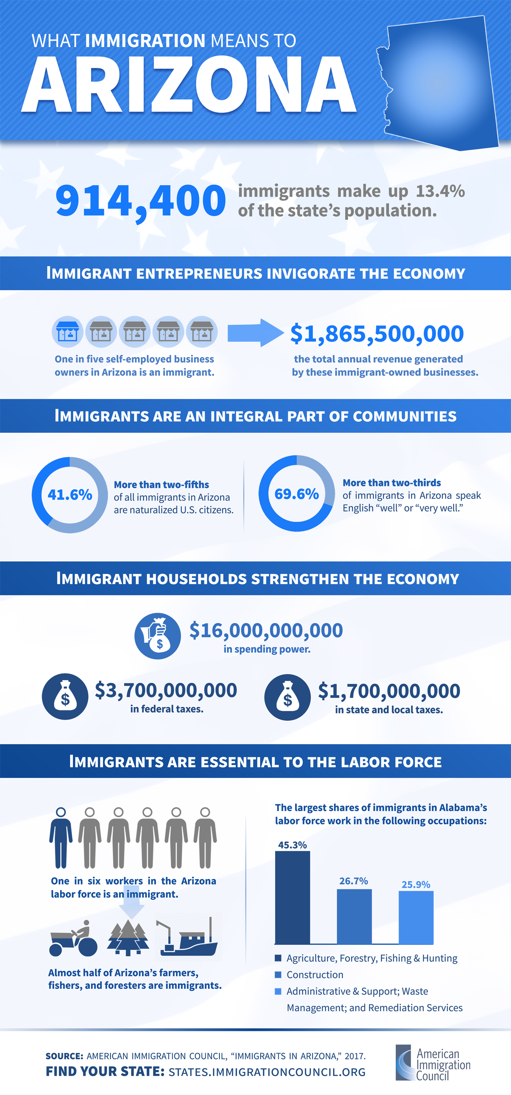
Source: American Immigration Council

Slide 26
AZ FACTOID
275,000 undocumented immigrants comprised 28% of the immigrant population and 4% of the total state population in 2016.
Source: American Immigration Council

Slide 27
Source: American Immigration Council

Slide 28
AZ FACTOID
466,047 people in Arizona, including 255,489 U.S. citizens, lived with at least one undocumented family member between 2010 and 2014.
The largest shares of immigrants in Arizona’s labor force work in the following occupations:
Source: American Immigration Council

Slide 29
Summary Conclusion:
Mass deportation is not immigration reform.
Mass deportation will harm our nation’s economy.
Mass deportation will carry an exorbitant price tag for taxpayers.
Mass deportation will exacerbate our labor shortage.
Mass deportation will compromise our nation’s values and liberties.
Mass deportation will further demonize people according to ethnicity.
Mass deportation will go down in history as one of our nation’s biggest mistakes.

Slide 30
Joseph Garcia
Joseph.Garcia@CPLC.org

