Slide 2
Boost US Construction Workforce by Employing More Immigrant Labor
Dr. Tony Payan
January 16, 2025

Slide 3
Introduction
The construction industry is a major pillar of the U.S. economy.
The industry contributed approximately 4.4% of the national gross domestic product in 2023.
It faces a severe labor shortage stemming from an aging workforce, lower birth rates, and decreased immigration.

Slide 4
Introduction
Over 40% of the current construction workforce is expected to retire within the next decade.
Recent policy changes, such as the Infrastructure Investment and Jobs Act of 2021, (also known as the Bipartisan Infrastructure Law), may further intensify the pressure on the construction industry.

Slide 5
National Labor Shortage
In 2023, there were 9.3 million job vacancies in the U.S.
Even with 100% workforce participation of unemployed workers, 3.2 million jobs would remain unfilled.

Slide 6
Role of Immigrants in the Construction Workforce

Slide 7
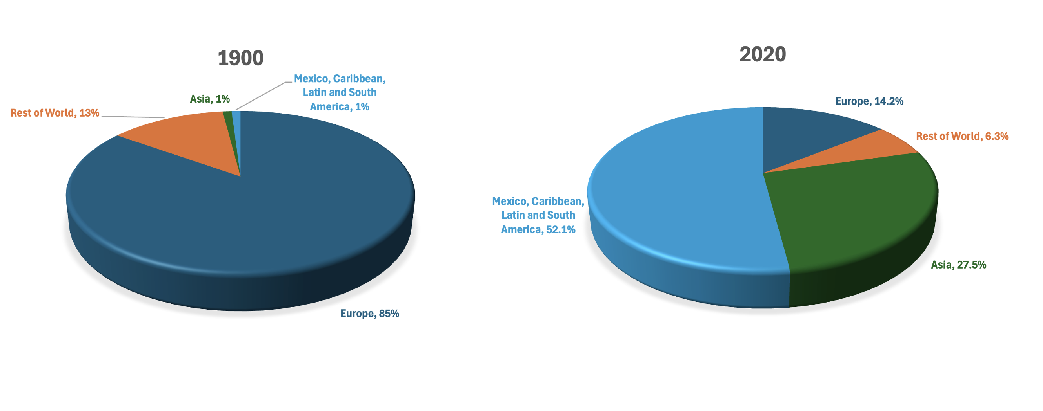
Origin of Persons in the US Born in Other Countries, 1900 and 2020
Source: U.S. Census Bureau

Slide 8
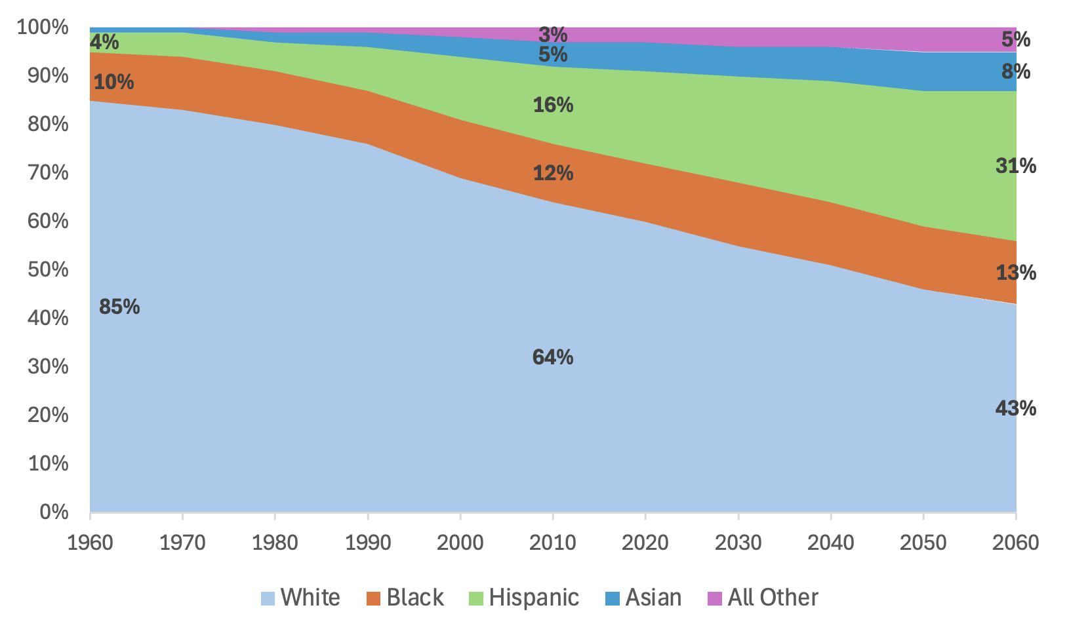
Race and Ethnicity Changes in the US, 1960–2060
Source: Paul Taylor, “The Next America,” Pew Research Center.

Slide 9
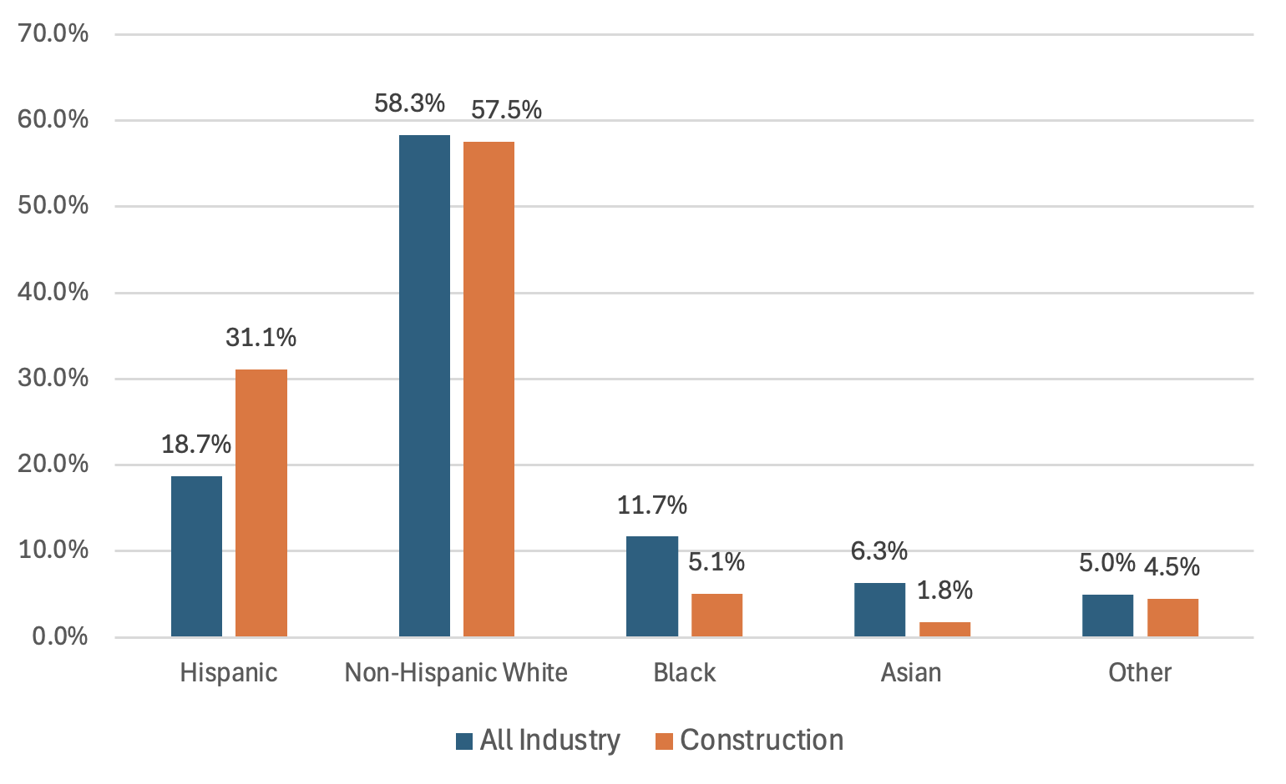
Labor Force by Race and Ethnicity, 2022
In 2022, the National Association of Home Builders estimated that Hispanics represented 31.1% of the construction industry’s workforce despite representing just 18.7% of the workforce among all industries.
Source: Na Zhao, “One in Three Workers in Construction Is Hispanic,” Eye on Housing.

Slide 10
Labor Force in the Construction Industry
The industry average for foreign-born workers is 25%.
More than 50% of construction workers in New Mexico, Texas, California, Arizona, and Nevada, are Hispanic.
Hispanics make up 47% of construction laborers and 53% of painters and paperhangers, a much higher representation than their overall share of the construction workforce, which stands at 30%.
Hispanics are the fastest-growing demographic group in the construction industry, with a growth rate of approximately 138% from 2001 to 2021

Slide 11
Promote Diversity in Construction Industry Corporate Culture
Diversity is a critical driver of innovation and resilience in the construction industry.
To truly embrace diversity, construction companies should implement training programs and policies that foster inclusivity.
Migrant labor is an integral part of the construction workforce, and by incorporating this reality into policy discussions and advocating for pathways to legal status for undocumented workers, the industry can help stabilize its workforce.

Slide 12
Education Levels
The construction industry relies heavily on workers with low levels of formal education.
Around 38.4% of Hispanic construction workers do not have a high school diploma, and an additional third did not pursue education beyond high school.
About 22% of Hispanic workers have education levels below ninth grade, compared to only about 2% of non-Hispanic workers

Slide 13
Labor Brokers and the Construction Industry
The labor brokers subcontracted the undocumented workers to show up, do the work and disappear afterward.
The workers were employed on the basis of an I-9 form.
While labor brokers provide the workers the industry needs, this approach has caused market distortions by making the workforce less reliable, increasing exploitation, and lowering work quality

Slide 14
Labor Brokers and the Construction Industry
There are negative effects for the entire sector and key impacts include:
The industry faces challenges relying on labor brokers for staffing.
Brokers often engage in unethical subcontracting practices, do not train their laborers or provide them with benefits.
Workers are more vulnerable to exploitation and poor working conditions.
Hispanic workers are disproportionately affected, as they are more likely to be targeted by harsh immigration policies.

Slide 15
Labor Brokers and the Construction Industry
Although using labor brokers has lowered construction companies’ benefit costs, other costs have grown.
Construction projects are frequently postponed or take much longer to complete than planned because the workforce is not always available or is unreliable.
Often because they lack training, those employed through labor brokers are more prone to accidents in the high-risk construction industry and then require hospital care.

Slide 16
Labor Brokers and the Construction Industry
Legal Issues:
Trafficking — When labor brokers recruit workers in other countries, they can inadvertently support the criminal networks that facilitate unauthorized entry into U.S. cities.
Wage Theft — Labor brokers often commit wage theft, taking advantage of undocumented workers who, fearing deportation, feel they have no recourse.
Tax Avoidance — Brokers often operate without leaving a trace of their activities and evade social security and payroll taxes.

Slide 17
Economic Impact of Legalizing Workers
The 2012 Deferred Action for Childhood Arrivals (DACA) program has already demonstrated the value of adding skilled workers to the economy.
Creating pathways for undocumented workers to stay legally can contribute to a more stable workforce.
Another possible solution is a policy proposal called “ID and Tax.”

Slide 18
Workforce Training and Education
Support Vocational Schools — Employers should actively support education reform bills that enable private companies to establish their own vocational schools.
Engage Families and Students About Construction Careers —Engaging families early to highlight the benefits of careers in this industry .

Slide 19
Recommendations
Promote Stability and Diversity in the Construction Industry Corporate Culture.
Establish Legal Pathways for Migrants: A Construction Visa.
Improve Border Infrastructure.
Target Workforce Training and Development

Slide 20
Conclusions
Construction companies must lead the charge for immigration reform and workforce development, advocating for policies that support a robust and equitable labor market and creating a corporate culture that embraces diversity.
An immigration policy change should include a national ID system for immigrants and full reinstatement of DACA provisions would significantly reduce the country’s labor shortage

Slide 21
Conclusions
Educational reform to enhance K-12 training in construction skills and increase industry engagement in schools can significantly strengthen this strategic sector.
A limited-term visa for Mexican and Central American construction workers would allow them to legally work in the U.S. and return home after the visa period.

